Slide 1
Proactive Road Modeling
Presented by : Team-13

Slide 2
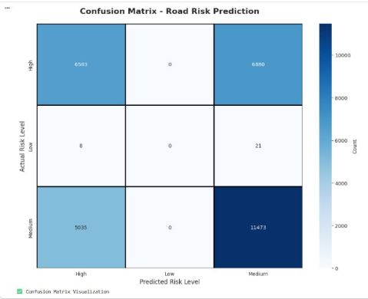

Model Evaluation
Evaluation metrics
Accuracy: Overall percentage of correct predictions made by the model.
Precision: Measures how many predicted risk cases are actually correct.
Recall: Measures how many actual risky cases are successfully detected.
F1 Score: Balanced measure combining Precision and Recall.

Slide 3
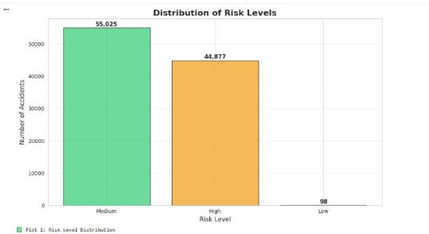

Comparison with baseline model

Slide 4
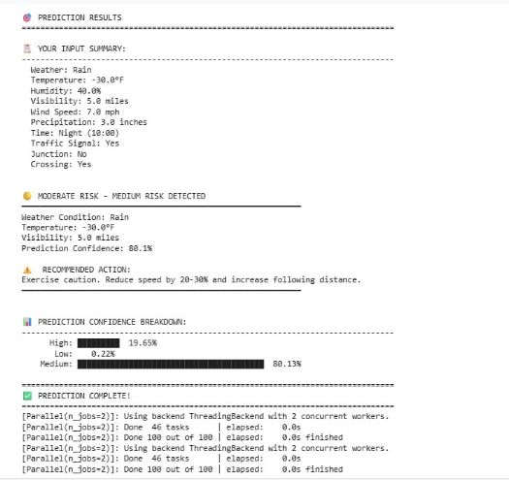
RESULTS & INTERPRETATION

Slide 5
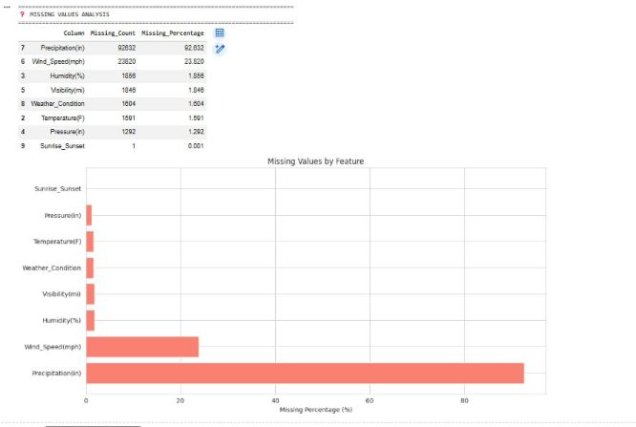
Visualization

Slide 6
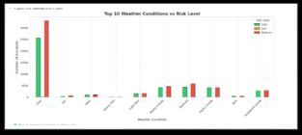
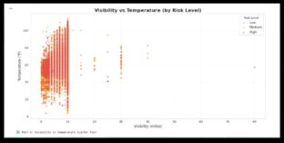
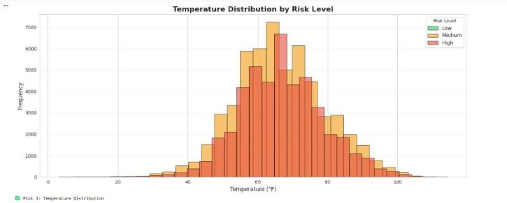

Slide 7
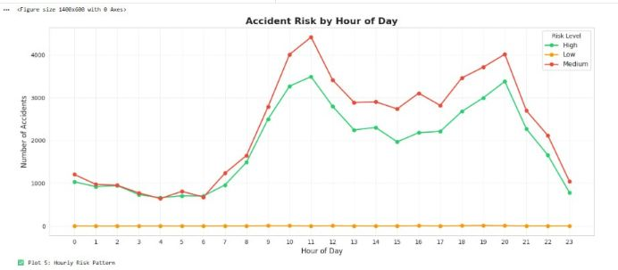
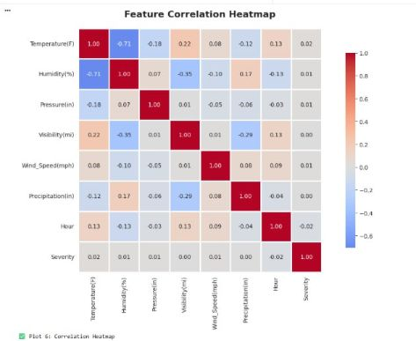
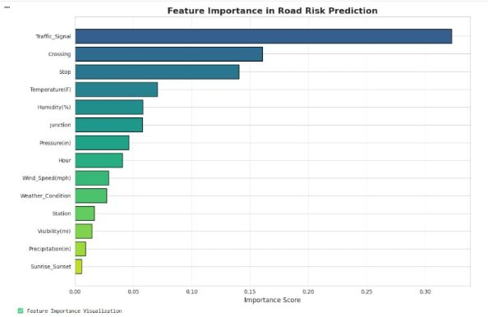

Slide 8
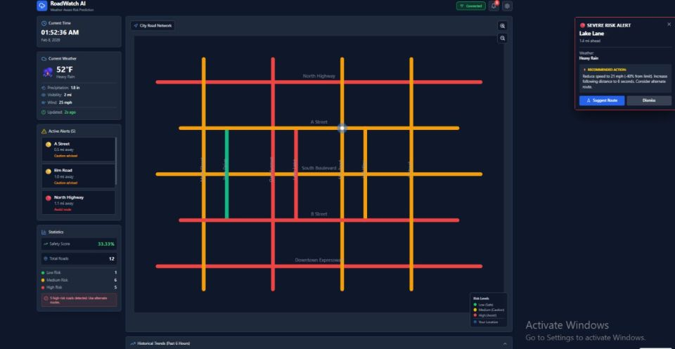

Conclusion & Future scope
Hyperlink(logo)

Slide 9
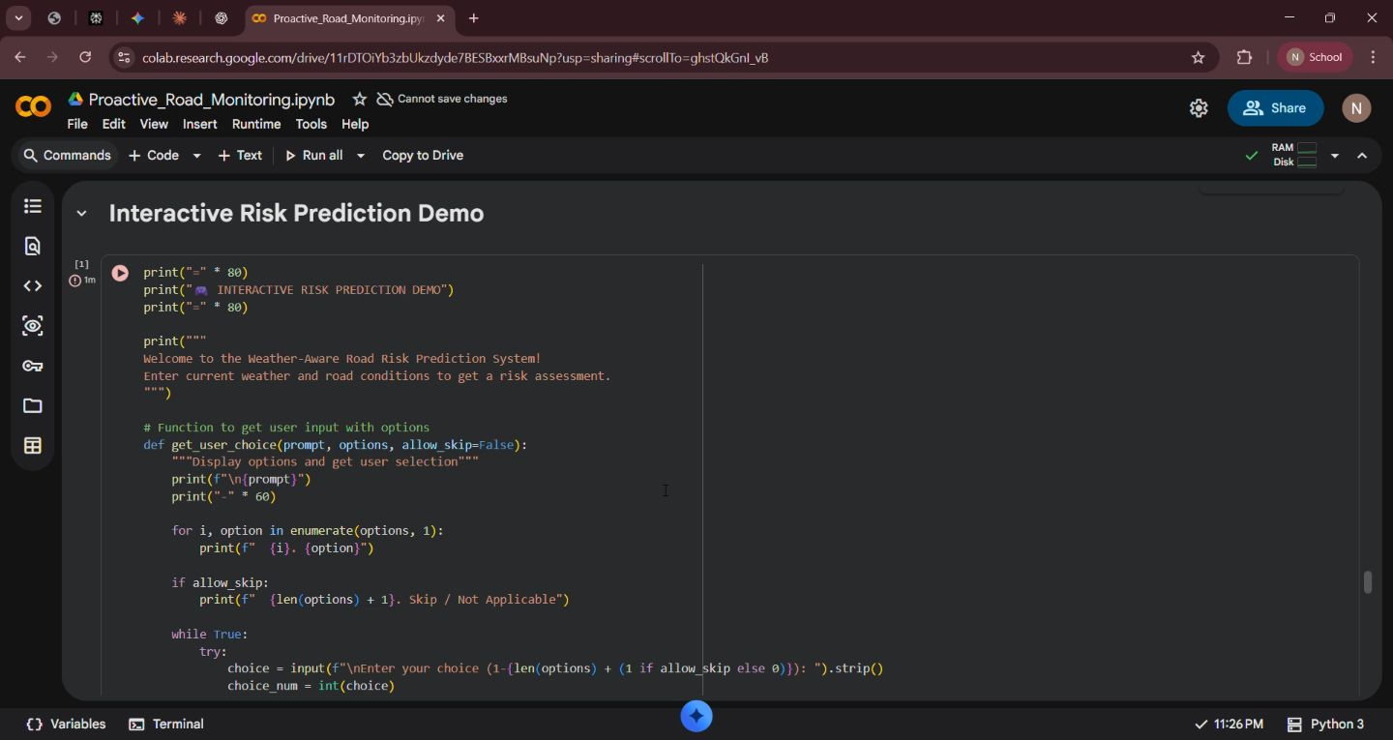
Visual representation of code and execution

Slide 10

Thank you !!!!!

